Slide 1
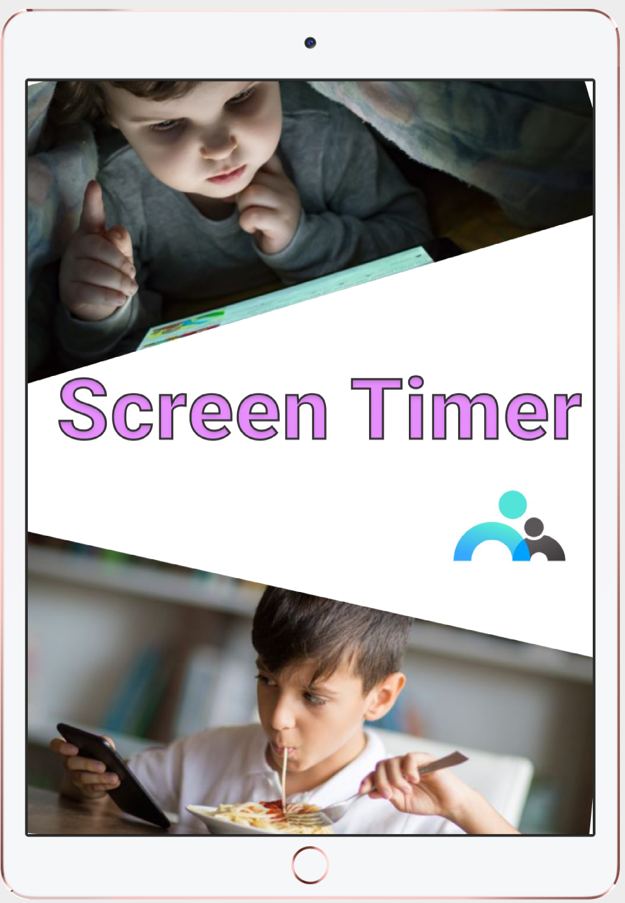
TEAM SKYNET
Presents

Slide 2

Let’s Get to Know Screen Timer!

Slide 3
User Need Analysis
Matrices -> Behavioral patterns vs attributes
Persona -> User characteristics/Setting
Storyboard -> Tasks expected
Low Fidelity Prototype -> Design implementation
LF Usability Test -> Understand user perception better
Notes:
Hope you understood what the issue is about. Yes, it is children addiction towards digital devices. And, there are various researches going on in this subject to prove that excess screen time causes harm in children physical and mental well being. To resolve this issue to a certain extent by having automatic time management, our team has implemented a solution that provides certain parental controls.
Before we proceed to the design principles that we had applied in the application, I would like to mention certain things on how we understood the issue and the user better. Understanding the user and his/her perception is very much essential for delivering any successful product. Mentioned are the concepts that helped us.
Matrices provided us an organized pattern of what will the expectations of various category of users be, or what will be the needs of various categories of users based on this issue. For eg : How will a stay at home lenient mom expect our solution to work? Similarly it made us research about what benefits can we provide to the user in order to allure them. It clearly showed us what are the facts and assumptions of the proposing solution.
By Persona, we were able to understand various user characteristics. For the video prototype shown, the user is a stay at home mom with two kids, and technically incompetent as well. So it made us analyse how our solution should be molded to satisfy such user.
Storyboard gave us a clear picture of what tasks will the above expect from the application.
Low fidelity prototype gave us an opportunity to design the paper prototype keeping in mind how user perception of all screens going to be.
And, finally LF usability test clearly showed how we as designers make flaws in understanding user perception. And it gave us the opportunity to design our prototype better.

Slide 4
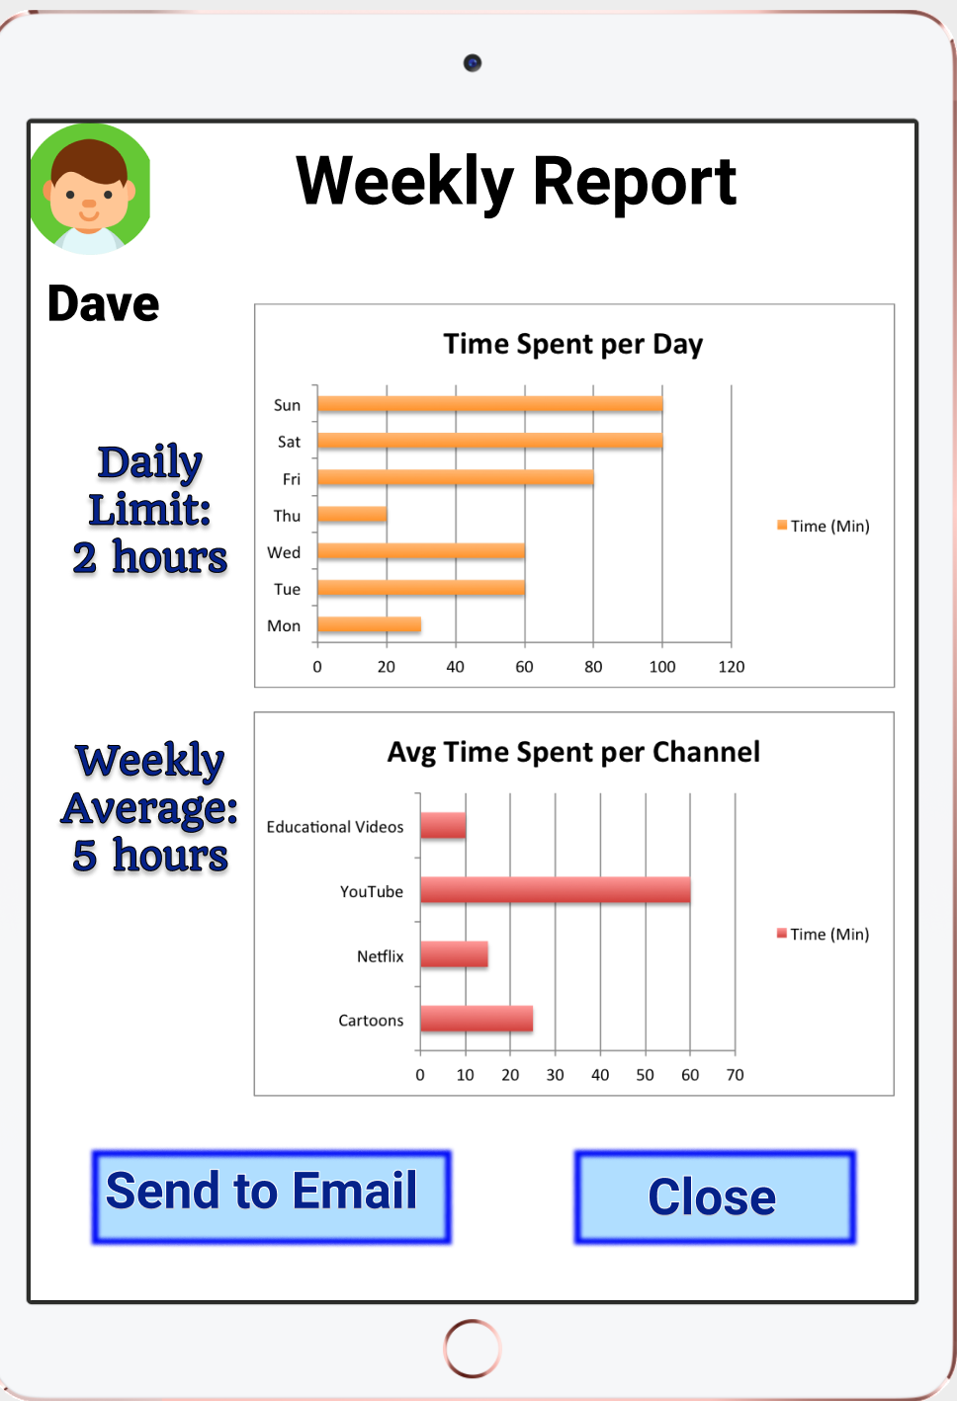
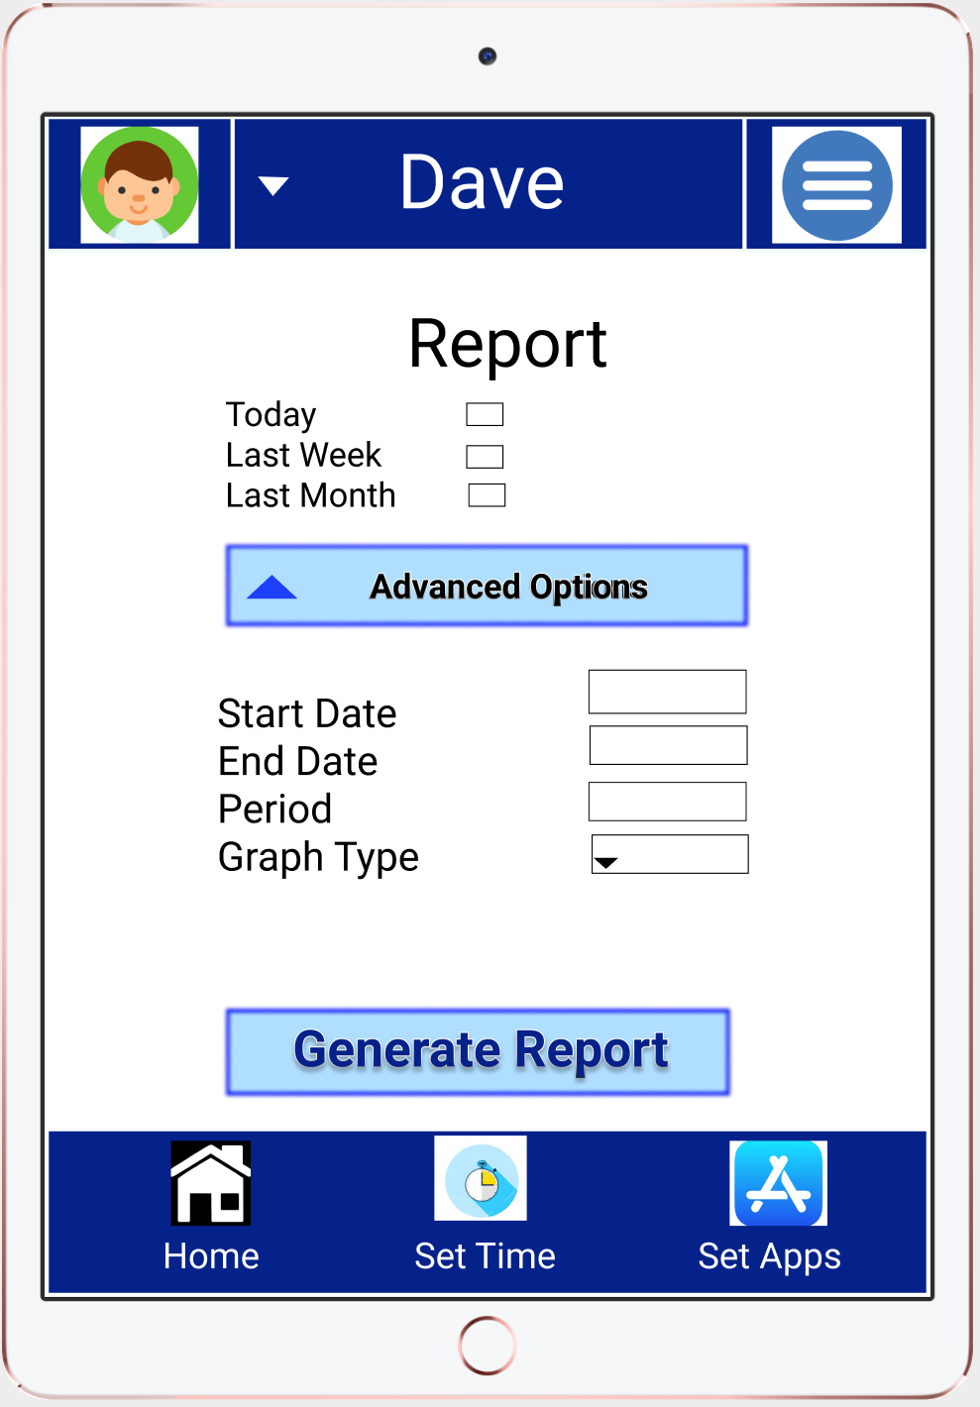
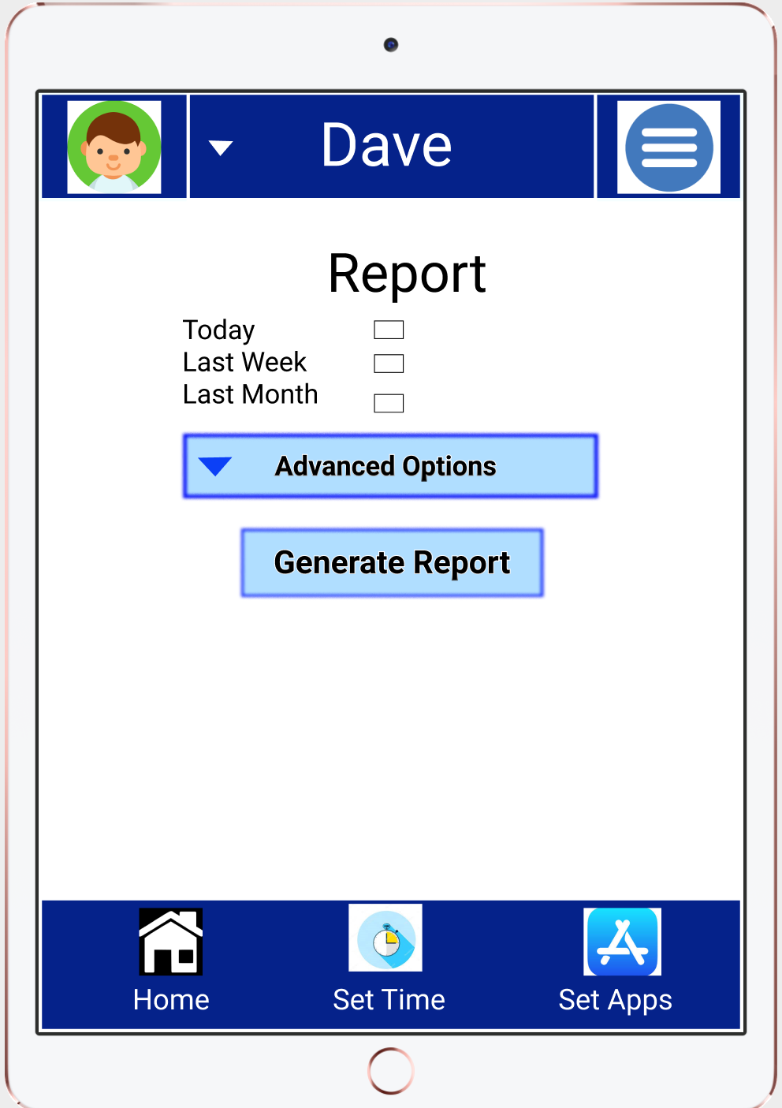
Gestalt’s Principle

Slide 5
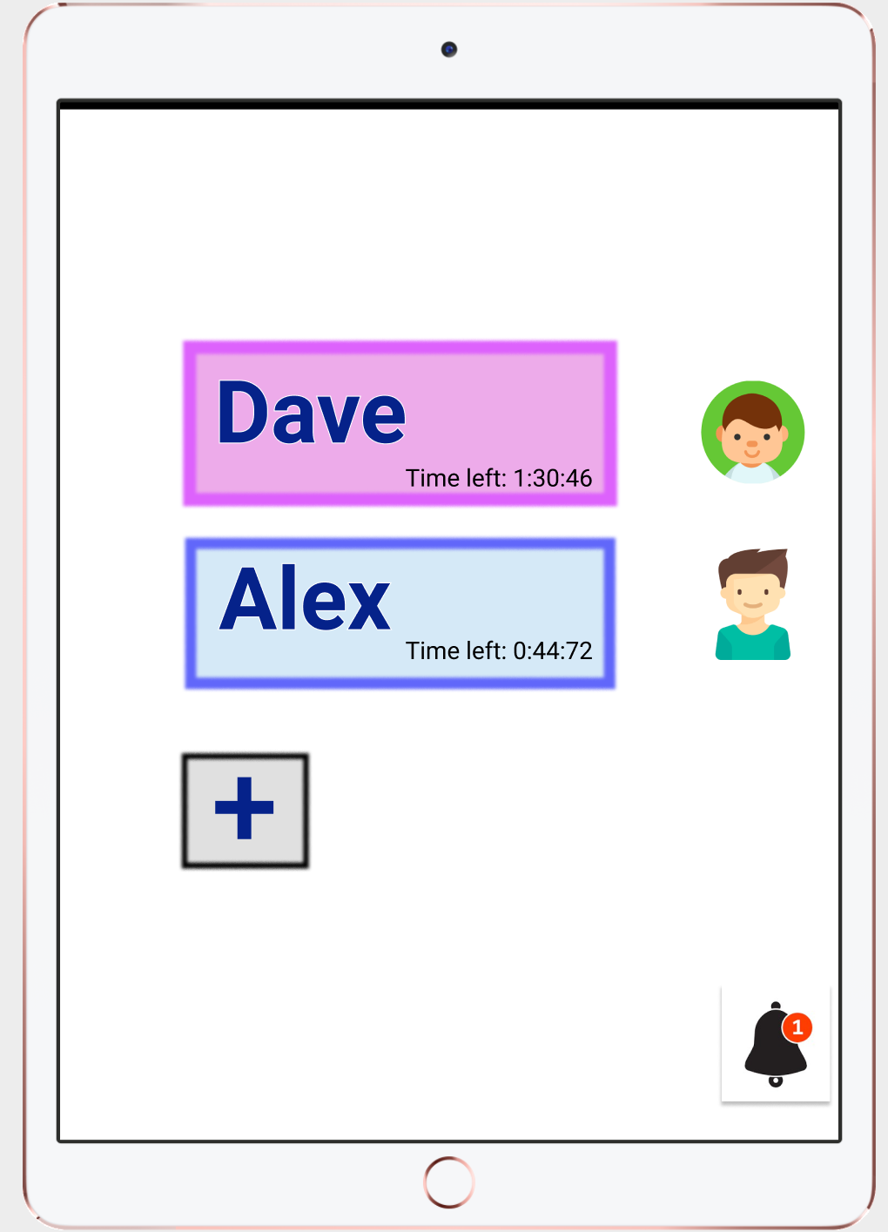
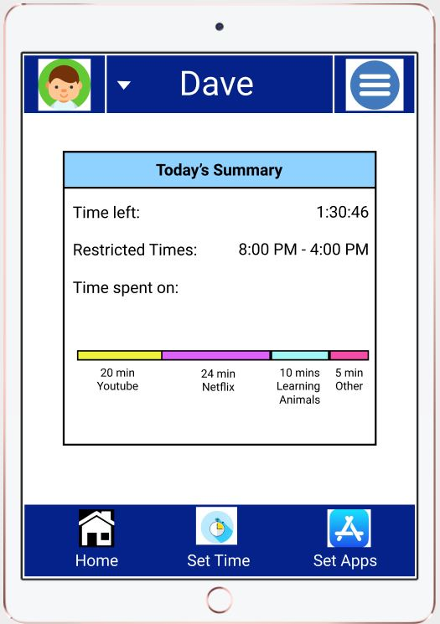
Principles Used to Create
User Oriented Application
Human recognize face faster than text
Peripheral Vision
Distinguish clickable buttons
Don’t rely on only solely on text or color
Notes:
According to Alex from Google, he recommended that human recognize face faster than text, so we took this as a consideration when parents have multiple kids, they should be able to recognize the face of their children from display pictures not only on text. The second is the Peripheral vision, if everyone recall the example that Alex gave us, tiger in the experiment room. He talked about human would be able to recognize something on the side or corner faster when things are moving, so we put the notification bell at the lower corner because we hope that user would be able to see it easily. The next points are the whole names and add button. We have seen many design examples in the class that user can’t distinguish between what are text and what are clickaw32ble buttons, so we carefully made these buttons to pop out so user knows that these button are able to do perform task and take them to another page. Another thing I would to talk about is I just saw he or she behind the screen, I would be curious to know what they are looking at, so we have made this bar to tell user what their kid were doing on the device and how long. In the way, we want to present it we want to present with both color and text, we don’t want to rely one only one of them. The same thing apply the name button we saw before, we want to assign kids, their own color.

Slide 6
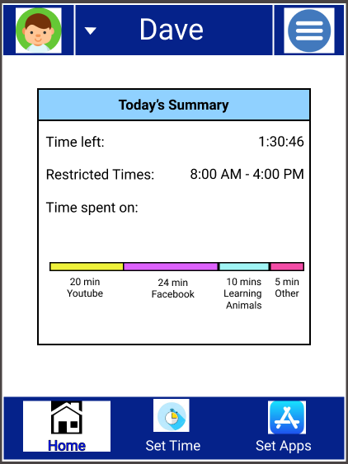
Principles

Slide 7
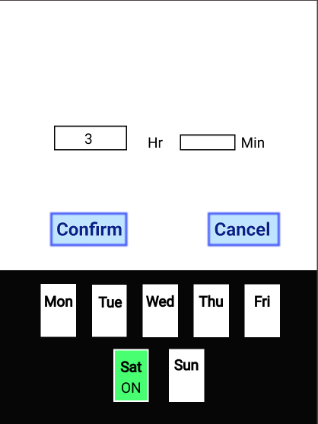
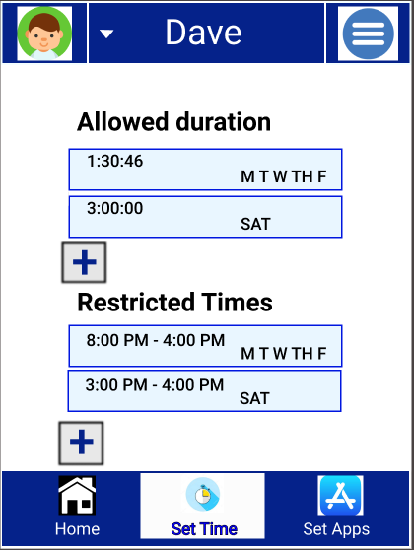
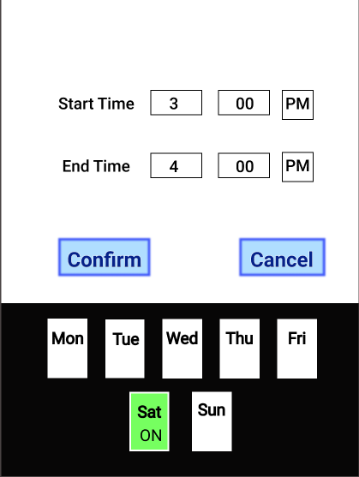
Law of Proximity and using Familiarity

Slide 8
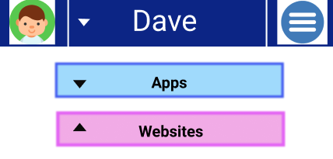
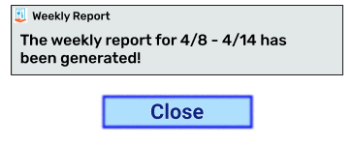
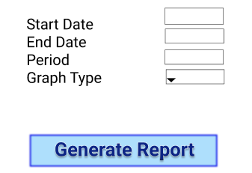
Perceptual Principles
Make displays legible
Notes:
One of the principles of perception involves making displays legible
These images depict our work in ensuring that all the text whether it be a line of information or labels is easy for the users with any vision level to understand

Slide 9
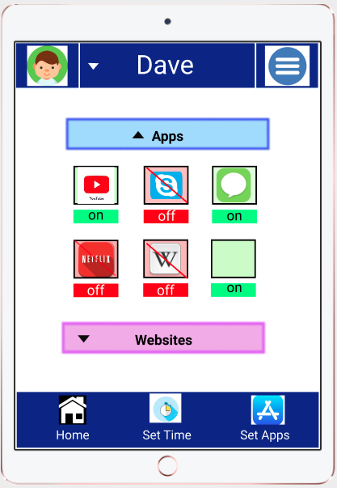
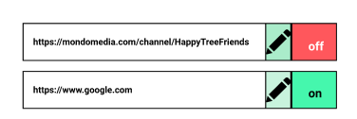
Perceptual Principles
Multi-Modality: using other forms
of representation
Notes:
Another perceptual principle is multi-modality, which means using other ways, rather than just text, to represent something
In the first image (on the left) we use text, on and off, but we also use red and green to represent that as well
In the other image we use text, on and off, as well as colors, and a red slash to symbolize the off button

Slide 10
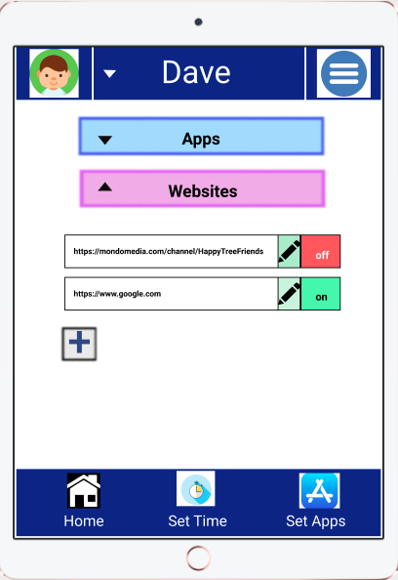
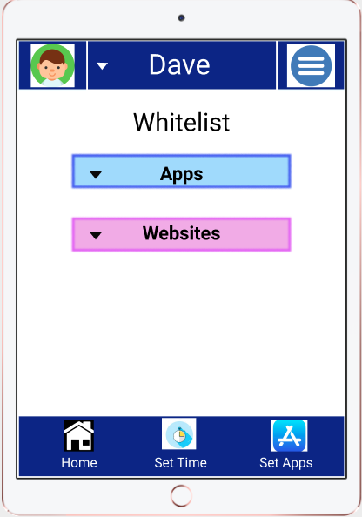
Perceptual Principles
Redundancy gain
Notes:
Another principle is redundancy
Now, redundancy is different from repetition
Repetition is seeing something over and over again to a point where it becomes unappealing to the senses
Redundancy, in this case, is seeing something enough times that it becomes an established pattern and the user gains recognition
All the images have a dark blue strip at the top of the bottom of the page. This will let the user know that these bars and everything in it are most likely the most important features of the application

Slide 11
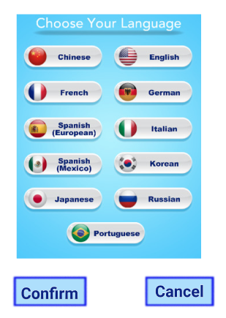
WCAG Principles
Perceivable
Large text
Language settings
Operable
Headings and labels that takes users to different screens
Understandable
No ambiguous terms
Navigation between screens is predictable and seamless
Robust
Compatible with different devices

Slide 12
Other Forms of Accessibility
So we decided to amplify elements that we could physically work with
Large text and buttons
So people with vision issues or Parkinson’s could read and navigate
Contrast
We used bright colors with neutral colors to keep things balanced
We also included enough white space between boxed elements for users to distinguish the separation
Used WebAim’s color contrast checker tool
No flashing screens
To cater to people who have are sensitive and prone to seizures

Slide 13
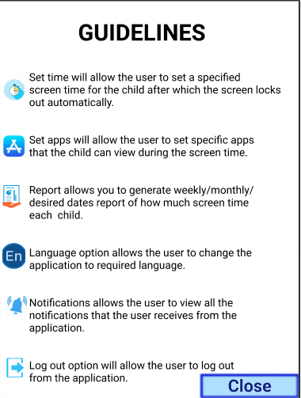
For extra help...
The guidelines page will help users learn
what each icon represents, which should
make their experience with this app even
more simple

Slide 14
User Feedback

Slide 15


